Slide 1
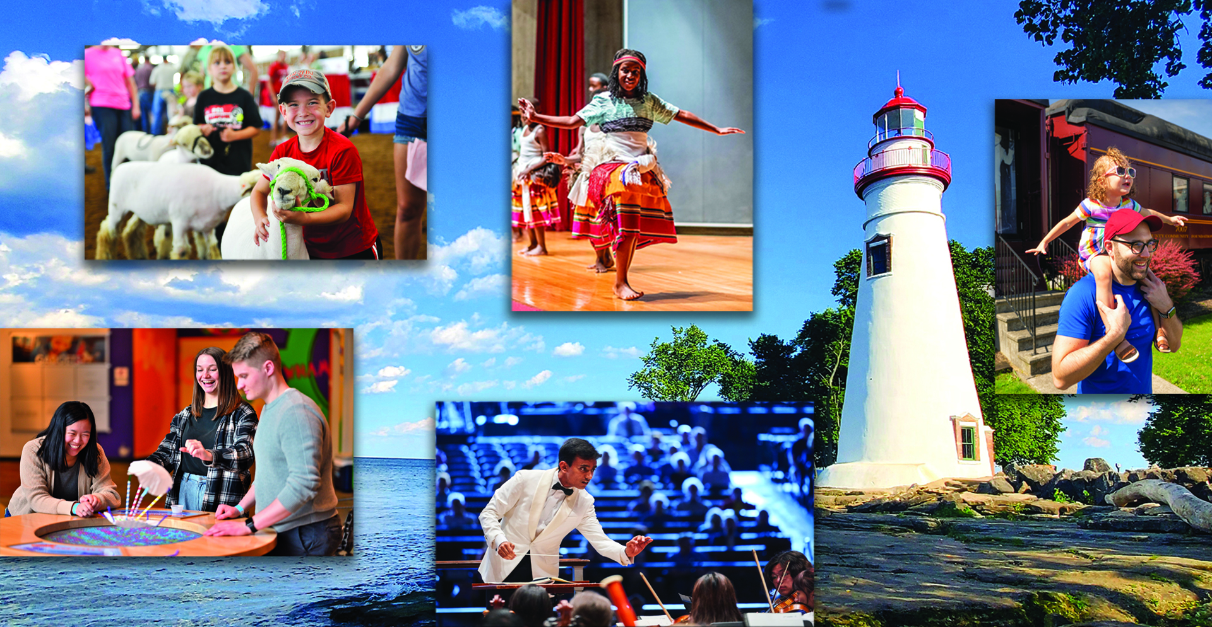
AM250-OHIO Grants Webinar
America 250-Ohio
Celebrating Ohio’s Contributions
to the U.S. for 250+ years.
Notes:
David

Slide 2
Grant Guidelines Webinar
Spring 2024 02.06.24
Presenter:
David Merkowitz, PhD
Director of Programs and Grants
Ohio Humanities staff member since 2011
Notes:
David and Todd

Slide 3
OHIO REVISED CODE: THE OHIO COMMISSION FOR THE U.S. SEMIQUINCENTENNIAL
“…to plan, encourage, develop, and coordinate the commemoration of the two hundred fiftieth anniversary of the founding of the United States and the impact of Ohioans on the nation’s past, present, and future.”
Ohio Revised Code (149.309)
Notes:
Todd

Slide 4
BUILDING BLOCKS
STRATEGIC INITIATIVES
88 county engagement and support
Statewide signature events and programs
Education
Public awareness strategy
Programs and projects produced with partners
Grants program to distribute funds for projects and community-led initiatives
Tourism, industry, stakeholder, and community-led events
Lead to Inspire:
planning, communication, and logistics.
Partner to Expand
mutual impact, resources, and ideas.
Support to Foster Participation of the public and organizations.
Notes:
Todd

Slide 5
OUR KEY MESSAGE​
To tell the story of Ohio's contributions to the U.S. for the past 250+ years and create a sense of pride about the impact that Ohio and Ohioans
have on the state, nation, and the world.​
Notes:
Todd

Slide 6
AMERICA 250-OHIO INITIATIVES WILL TELL THE STORIES OF OHIO
Stories that will be developed and shared using these values:
Contributions – People sharing their Ohio stories (personal, family, organization, community)
Collaboration – People working together to tell the stories
Commemoration – People telling stories that are under-told, difficult, or nuanced
Celebration – People celebrating milestones and moments
Past
Present
Future
Interpretation
Celebration
Commemoration
Heritage
Reflection
Preservation
Education
Building for the next generation
Notes:
Todd

Slide 7
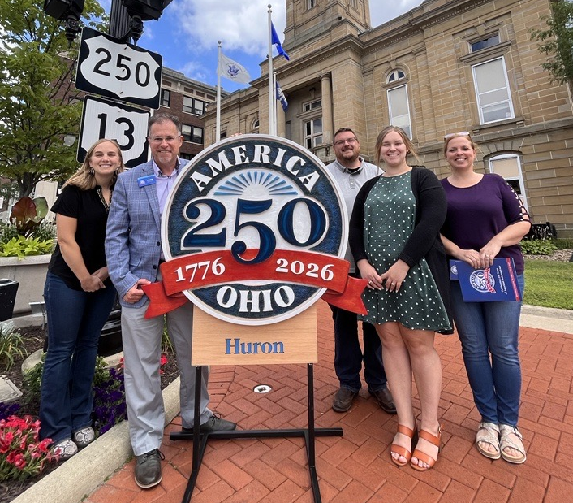
THEMES – KEY CONTENT AREAS
Celebrations and Signature Events: Impacting Tourism and Economic Development
Ohio Originals: Highlighting Points of Pride & Unity
Engaging Youth and Lifelong Learners: Education & Scholarship
Inclusive Statewide Engagement: Museums, Arts & Culture
Telling Ohio Stories: Highlighting stories of Ohioans past and present
Notes:
Todd

Slide 8
AMERICA 250-OHIO GRANTS PROGRAM
Grant funding pool of approximately $1 million in
FY 2024. The Fall Cycle distributed $400,000. Approximately, $600,000 will be awarded this cycle.
These funds will support local and statewide programs and projects related to America 250-Ohio themes. ​
Notes:
Todd and David

Slide 9
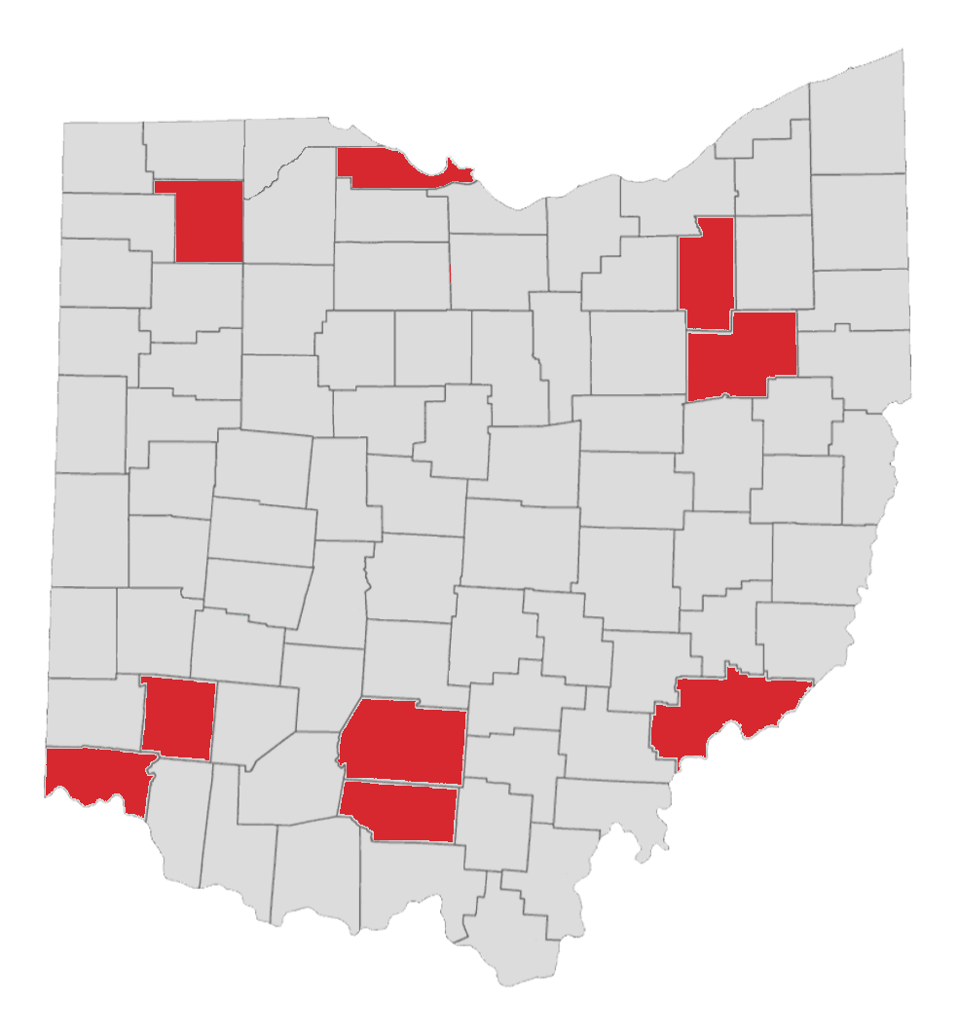
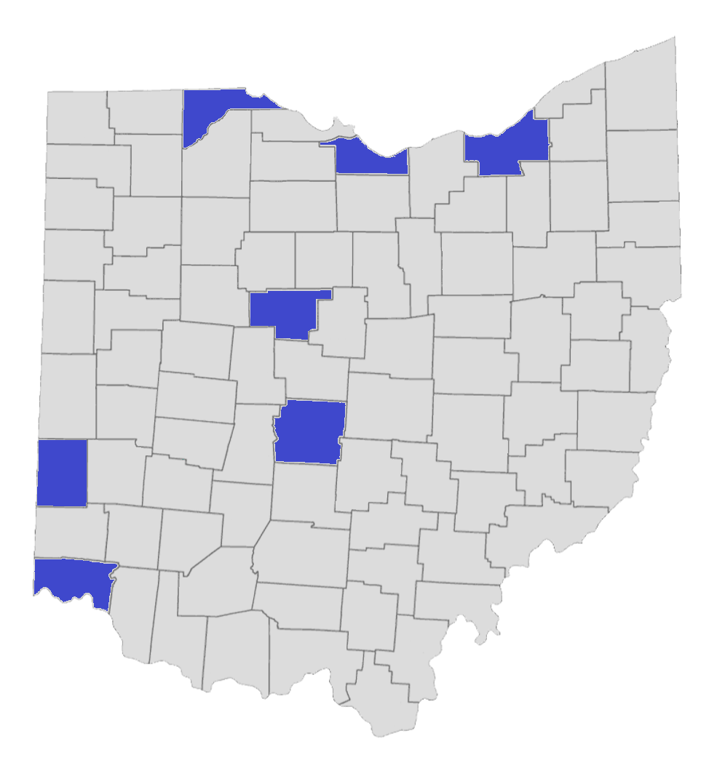
AMERICA 250-OHIO FALL CYCLE GRANTS
Buckeye Grants
75 Applications Received
23 Grants Awarded
Trillium Grants
13 grants
~$360,000 Awarded
Range of Awards: $9,700 - $40,000
9 grants
~$40,000
Range of Awards: $2,481 - $4,800
Notes:
Todd and David

Slide 10
Spring 2024 Cycle
Grant Application available: January 15, 2024
Grant Applications due: March 15, 2024
Grant Cycle Webinar I: February 6
Grant Decisions: Mid-May 2024
Period of performance: June 15, 2024, through May 31, 2025.
Grant Cycle Webinar II: March 6
To tell the story of Ohio's contributions to the U.S. for the past 250+ years and create a sense of pride about the impact that Ohio and Ohioans
have on the state, nation, and the world.​
When?
Notes:
David

Slide 11
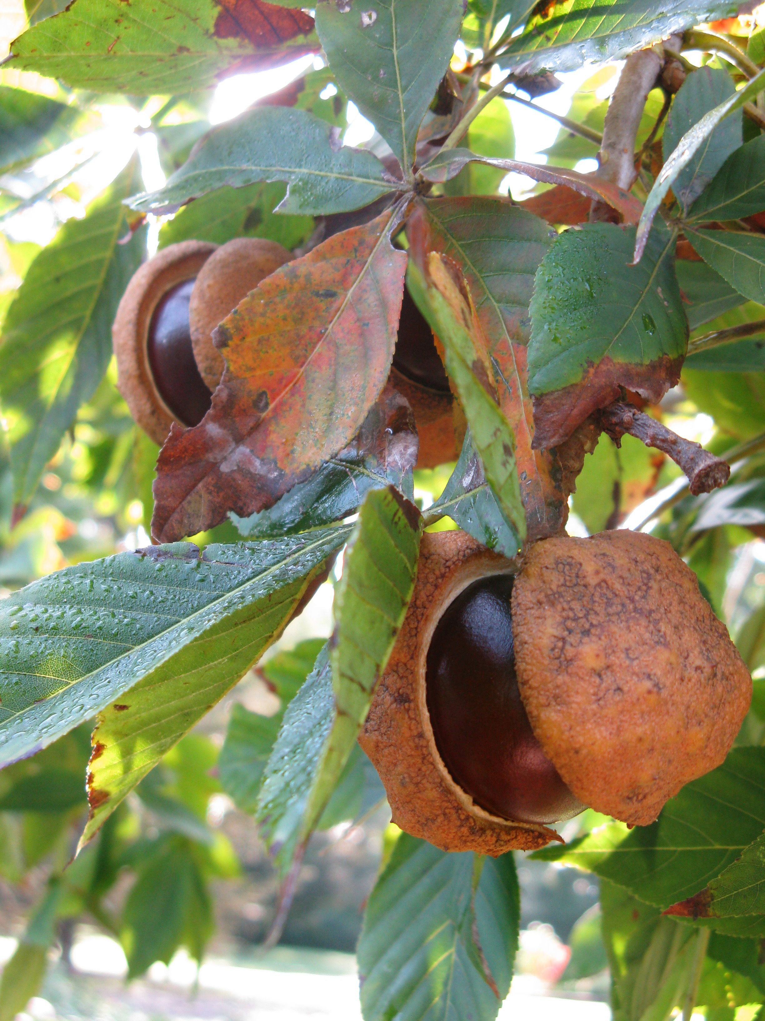
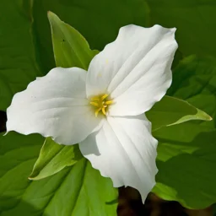
What kinds of grants are these?
Buckeye Impact Grants
Grant amounts up to $50,000
Requests that approach $50,000 must have a concrete and substantial statewide audience.
Projects should have a statewide, regional, or significant local impact.
Project types may include significant exhibitions, regional commemorative activities, substantial digital and documentary media projects, and signature public events.
Trillium Local Activity Grants
Grant amounts up to $5,000
Projects should have a local or community-wide impact.
Project types may include exhibitions, exhibits, interpretative panels, local commemorative programs or activities, local public events, educational and public programs, and smaller digital and documentary media projects.
Notes:
David

Slide 12
Who is eligible to apply?
Non-profit organizations registered with the State of Ohio and located in Ohio.
Notes:
David

Slide 13
Who is eligible to apply? (Special Situations)
State agencies may not directly seek support.
Individual artists, authors, or performers
Apply through a fiscal agent/sponsor.
Must use a fiscal agent/sponsor or a Friends group to seek support for eligible activities.
Eligible organizations when the funds are just used for 250th Anniversary related projects.
School Districts and other K-12 educational institutions
Local and Regional Governmental entities (e.g. libraries and other local governments)
Institutions of Higher Education
Faith-based organizations
Cannot advocate for religious beliefs as part of the funded activities
Notes:
David

Slide 14
What kinds of grants are these?
The grants are available for projects, programming, and non-capital physical investments.*
A project grant supports a specific set of activities that has a clear beginning and end point and a specific set of pre-established outputs and outcomes.
Physical plant investments must align with the purpose of the grant program
*Guideline Clarification – the construction of monuments is considered a capital expense and are not eligible for the physical component.
Notes:
David

Slide 15
Cost-share
Eligible costs include
Ineligible costs include:
Capital expenses*
Artistic materials and equipment not related to AM250-OH activities
Non-AM250-OH mission-related operating costs
Equipment costs (cameras, computers, hard drives, etc.) not related to an AM250-OH activity
Fundraising efforts
Lobbying
Costs related to any project whose primary purpose is to promote partisan political ideologies or religious proselytization
Scholarship assistance
Staff salaries at a K-12 school
High School or College student pay
University faculty salary and costs that are not directly related to the project
Food and alcohol
Personnel
Experts/scholars
Travel and per diem
Outreach/advertising
Project activity costs
Up to 10% for indirect costs.
No cost-share is required. Sponsoring organizations will report the full cost of the project.
The Budget
Notes:
David

Slide 16
Topics of Note
Arts Projects
Balanced Viewpoints
Assurance of Accuracy and Context
Living history and historical reenactment projects
Arts are eligible if they include significant interpretive or educational components of the project relevant to AM250-OH.
Public programs should encourage open conversations among speakers and audience members.
Projects that address historical, cultural, and civic topics should ensure that the project presents historical and civic topics in an accurate and contextualized fashion.
Historical reenactment must depict events that originally occurred in Ohio and in the general area where the contemporary project will take place. Events must be relevant to the War for American Independence.
Representations of Native Americans or enslaved peoples in a Living History project must be carried out by a member in good standing of the group.
Digital Projects
Applications that require a new download has a higher bar than projects that utilize tools already present on devices.

Slide 17
THEMES – KEY CONTENT AREAS
Celebrations and Signature Events: Impacting Tourism and Economic Development
Ohio Originals: Highlighting Points of Pride & Unity
Engaging Youth and Lifelong Learners: Education & Scholarship
Inclusive Statewide Engagement: Museums, Arts & Culture
Telling Ohio Stories: Highlighting stories of Ohioans past and present
Notes:
David

Slide 18
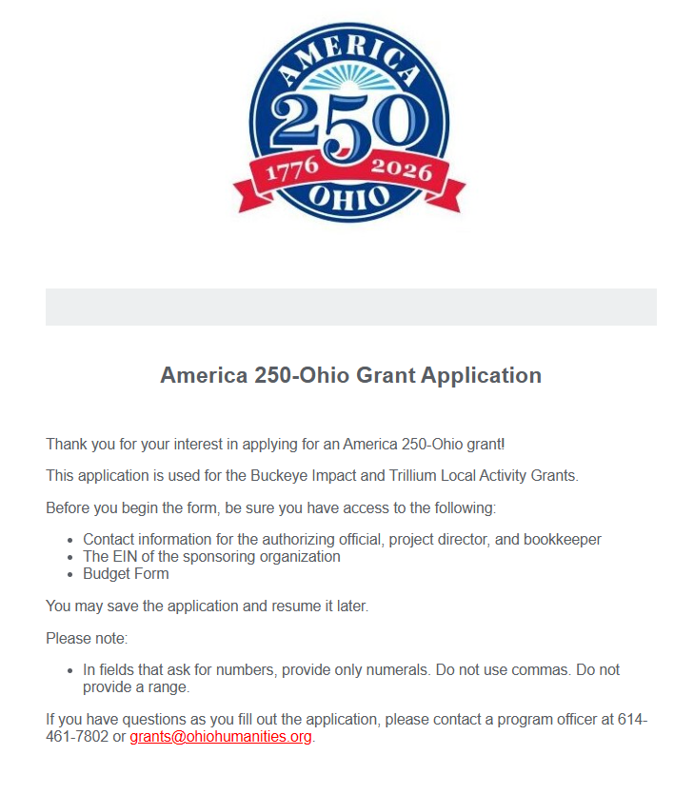
Changes from Fall Cycle:
County Field
Timeline Field
Application Website
https://ohiohumanities.formstack.com/forms/america_250_grant_application
Notes:
David

Slide 19
Application: Narrative Questions
Q1. What do you want to do in this project that will be carried out with AM250-OH funds?
1) the specific details you have planned for the project (the who, what, where, and when of the project)
2) why it’s important to address this topic now?
3) What are the overall goals of the project and how will you evaluate the success of the project?
Q2. AM250-OH grants seek to advance awareness and knowledge of the themes set out by the America 250-Ohio Commission. The grants may also support projects that explore and exemplify the ideals represented in the Declaration of Independence as revealed in the long history of America. The key objective of these grants is to explore the story of Ohio’s contribution to United States history and culture and foster a sense of pride about the impact that Ohio and Ohioans have had on the state, nation, and beyond.
How does your project align with the goals and objectives of the AM250-OH Commission?
Q3. Project Personnel
Part 1. Identify the key individuals who will contribute to the success of the project.
Part 2. (If relevant) Who are the experts involved in the program?
Q4. Describe the intended audience for the project or organization.
What is the expected attendance for any public events or activities?
What kind of outreach will be carried out to the intended audience?
For media projects, how many individuals do you expect will view the finished work?
Provide a timeline of outreach activities; be sure to allow for adequate time to reach the desired audience.
Q5. Who is the sponsoring organization?
Describe the mission and purpose of the sponsoring organization that is requesting the funds.
How will the grant project align with the organization’s mission?
Are there partners involved in the project? If so, please describe them and their role in the project.
Notes:
David

Slide 20
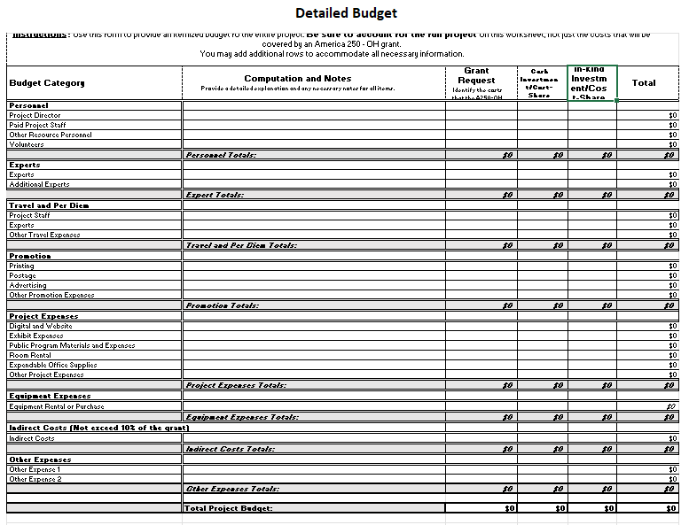
Application: Budget and Website
Notes:
David

Slide 21
Next Steps:
Review Grant Guidelines
Talk to a Program Officer
Complete the Grant Application
Available on the AM50-Ohio and Ohio Humanities websites
Email or Call David or Aaron
dmerkowitz@ohiohumanities.org
grants@ohiohumanities.org
Phone: 614-461-7802
Due March 15
Sign-up for Webinar II, March 6
Notes:
David

Slide 22
STAY INFORMED – FOLLOW US!
@America 250-Ohio
@am250ohio
@America 250-Ohio
#America250Ohio
https://america250-ohio.org
info@america250-ohio.org
Notes:
You can stay in touch by following our social media channels or visiting our website.

